Slide 1
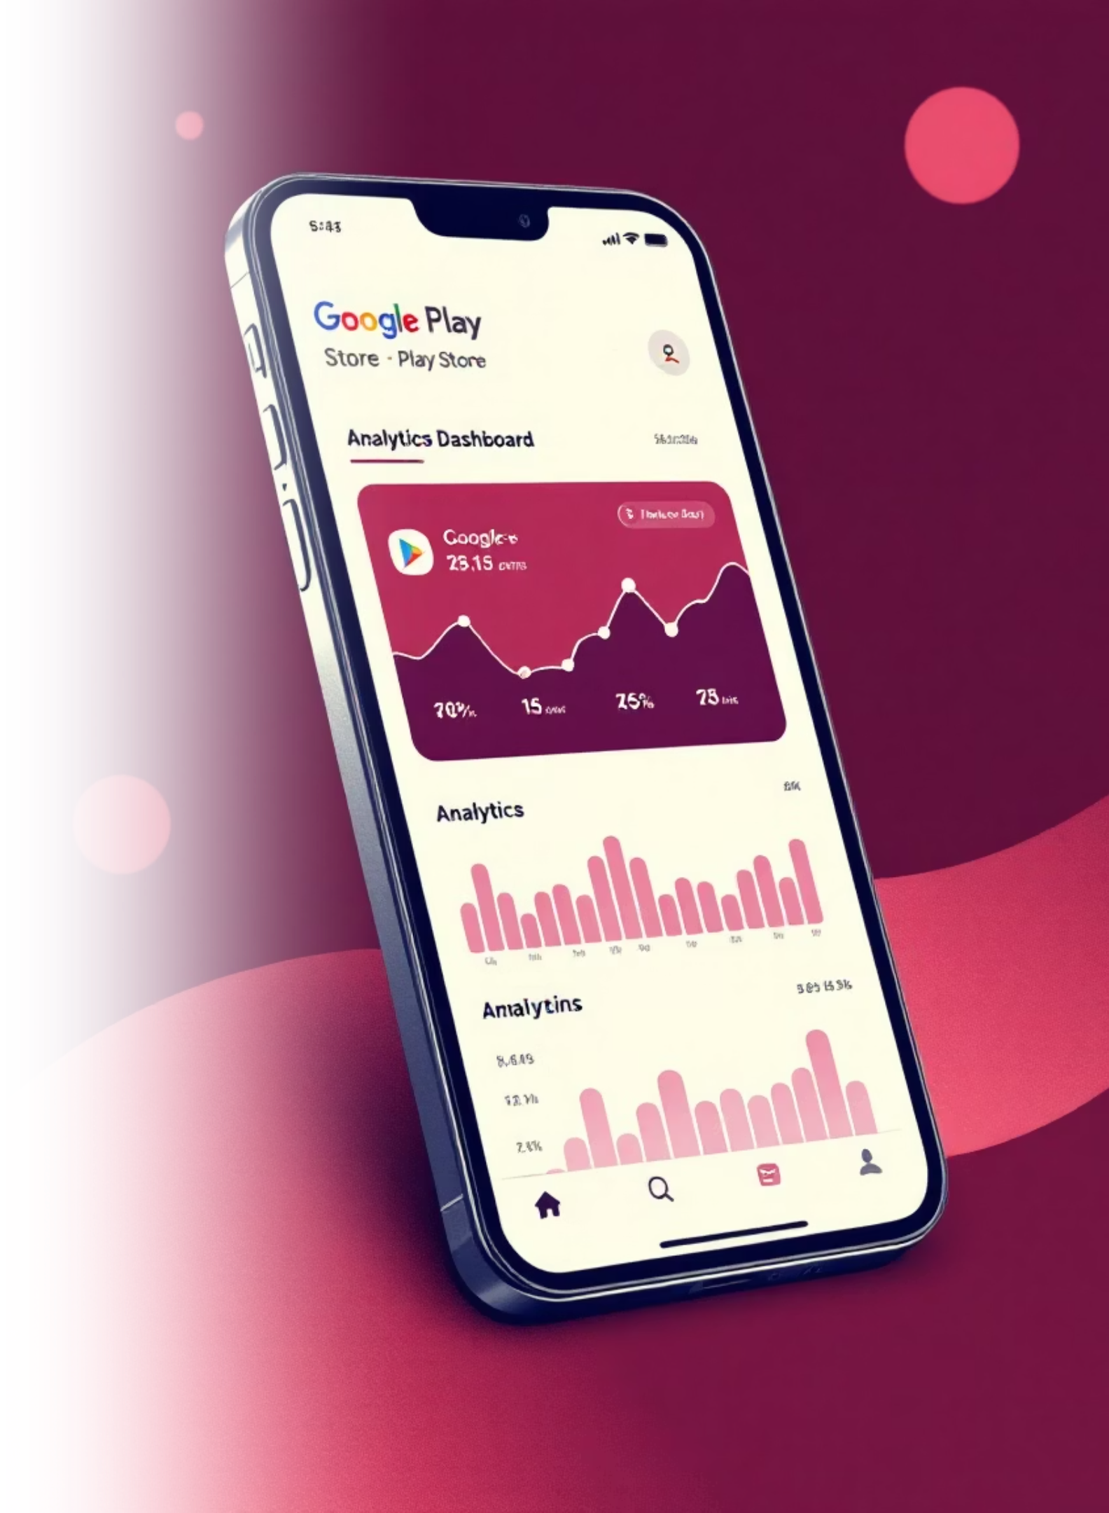
Google Play Store Analysis
Comprehensive data insights for app performance optimization

Slide 2

Project Objective
Primary Goal
Key Focus Areas
Analyze Google Play Store data to extract actionable insights about app performance, user preferences, and market trends
App ratings and user sentiment
Category performance analysis
Download patterns and trends
Pricing strategy insights

Slide 3






Tools & Software Used
Python
Jupyter Notebook
Core programming language for data analysis and statistical computing
Interactive development environment for data exploration and documentation
Pandas
Matplotlib
Data manipulation and analysis library for structured data processing
Comprehensive plotting library for creating static visualizations
Seaborn
Power BI / Tableau
Statistical data visualization built on matplotlib for advanced graphics
Business intelligence platforms for interactive dashboard creation

Slide 4
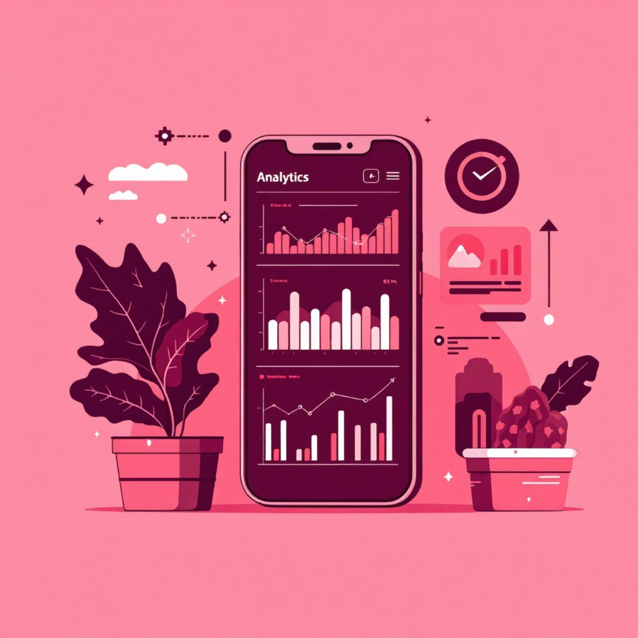
Dataset Overview
Google Play Store Dataset
Comprehensive collection of app metadata providing deep insights into mobile application ecosystem performance and user engagement patterns.
10,841 Apps
Diverse range of applications across multiple categories
13 Key Attributes
Rich metadata including ratings, reviews, installs, and pricing
Core Attributes: App names, categories, ratings, review counts, install numbers, size, pricing, content ratings, and last update dates

Slide 5





Project Process
Data Collection
Gathered comprehensive Google Play Store dataset with app metadata and performance metrics
Cleaning & Preprocessing
Removed duplicates, handled missing values, and standardized data formats for analysis
Exploratory Data Analysis
Statistical analysis to understand data distributions, patterns, and relationships
Data Visualization
Created compelling charts and graphs to communicate findings effectively
Insights Generation
Extracted actionable business intelligence from analyzed data patterns

Slide 6
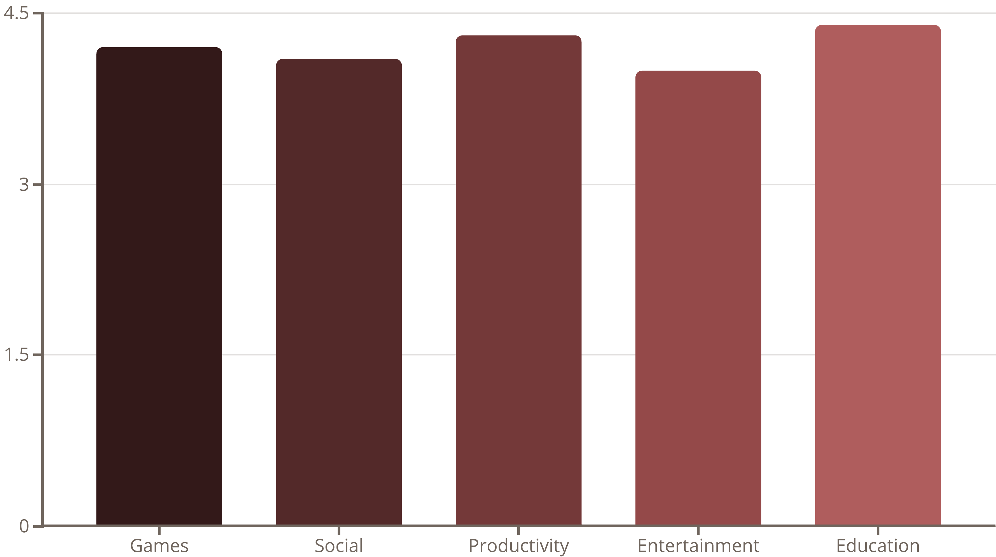
App Category Performance
Education and Productivity apps consistently achieve the highest user satisfaction ratings, while Games dominate in total download volume despite slightly lower average ratings.

Slide 7
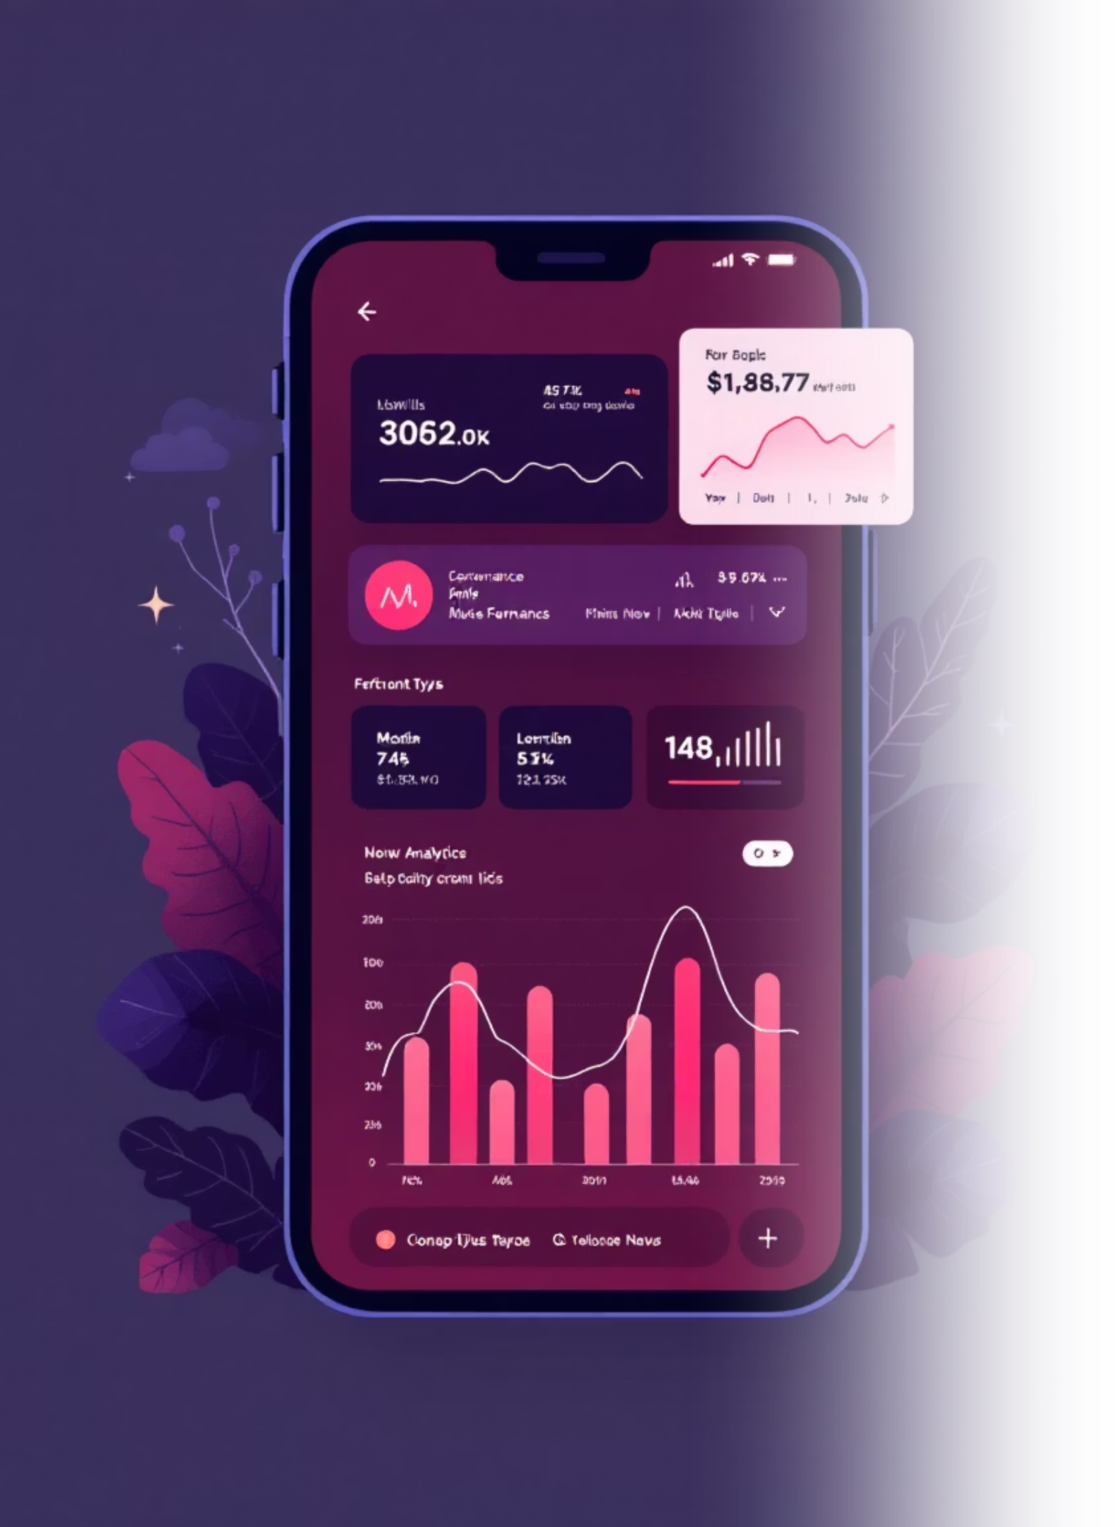
Key Performance Insights
4.3
89%
1B+
Average App Rating
Free Apps
Top Install Range
Percentage of apps using freemium model
Most successful apps achieve billion+ downloads
Overall user satisfaction across all categories
33
App Categories
Diverse ecosystem spanning multiple verticals

Slide 8



Critical Success Correlations
Rating vs. Install Relationship
Strong positive correlation between user ratings and download volume, with apps above 4.0 stars showing significantly higher install rates.
73%
High-Rated Apps
Apps with 4+ stars achieve higher install volumes
45%
Review Impact
Increase in downloads with active review engagement
Key Finding: Apps with regular updates and active user engagement maintain higher ratings and sustained growth in downloads.

Slide 9
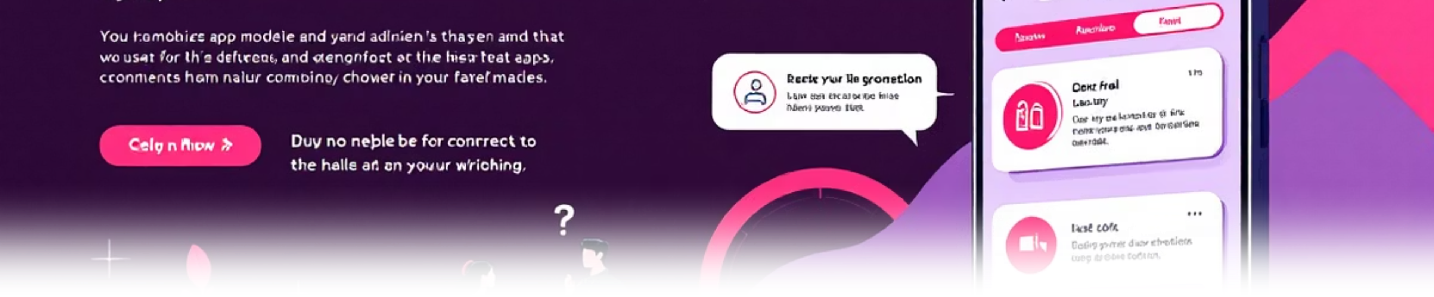



Pricing Strategy Analysis
Freemium Dominance
Premium App Sweet Spot
Subscription Growth
89% of successful apps use free-to-download model with in-app purchases generating primary revenue
Paid apps priced between $0.99-$4.99 show optimal balance of conversion and revenue generation
Monthly subscription models in productivity and entertainment categories showing 35% year-over-year growth

Slide 10

Strategic Recommendations
Focus on User Experience
1
Prioritize app quality and user satisfaction to achieve ratings above 4.0 stars, directly correlating with increased downloads and retention
Optimize Category Positioning
2
Target high-performing categories like Education and Productivity for better user engagement and rating potential
Implement Freemium Strategy
3
Adopt free-to-download model with strategic in-app purchases to maximize user acquisition and revenue generation
Data-driven insights empower developers to make informed decisions that optimize app performance and maximize market success.

